Slide 1

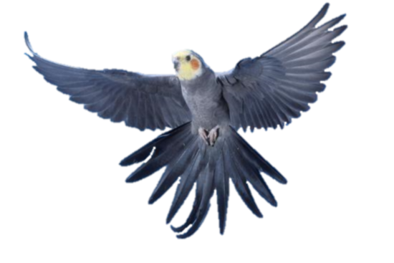
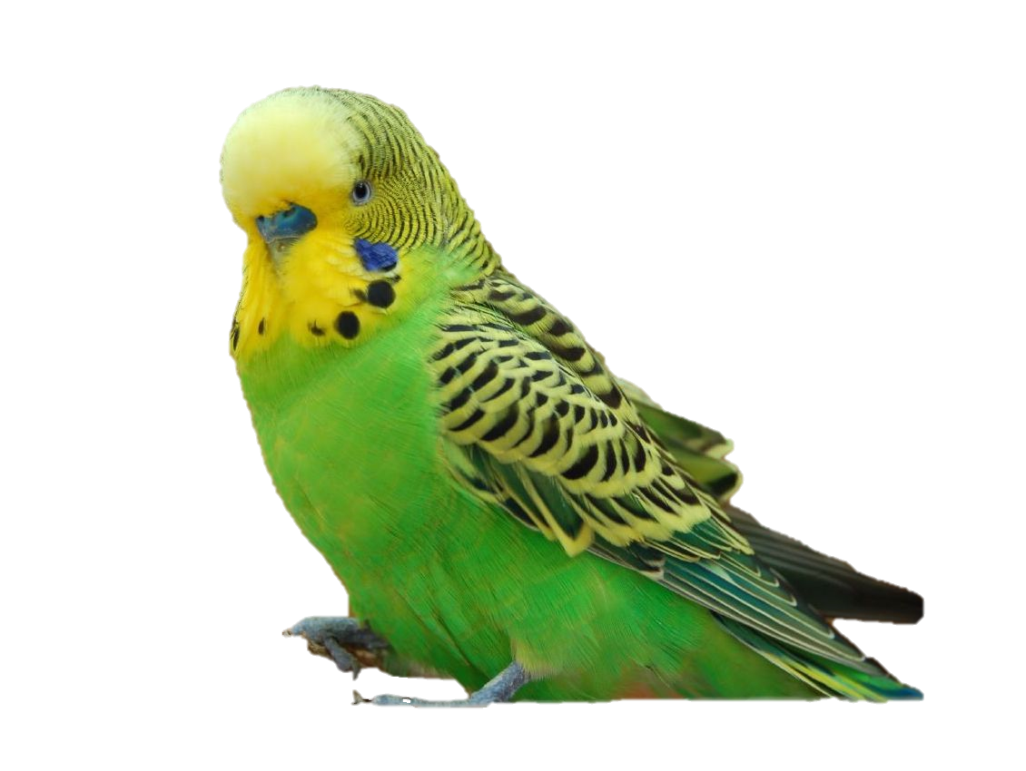
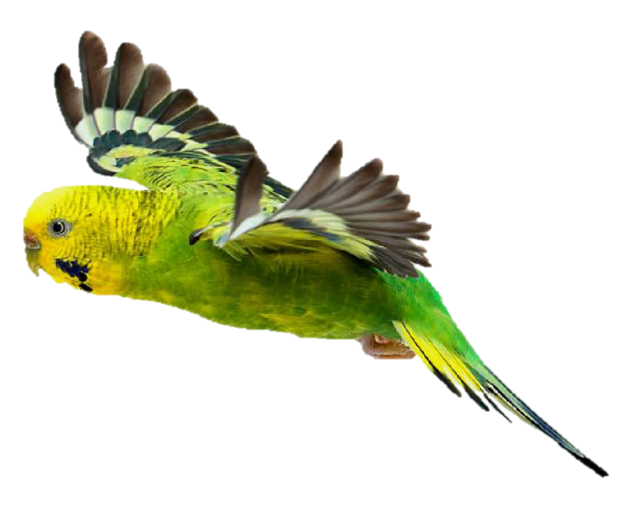
BEFORE YOU FLY
Things you should know before buying a pet parakeet or cockatiel

Slide 2
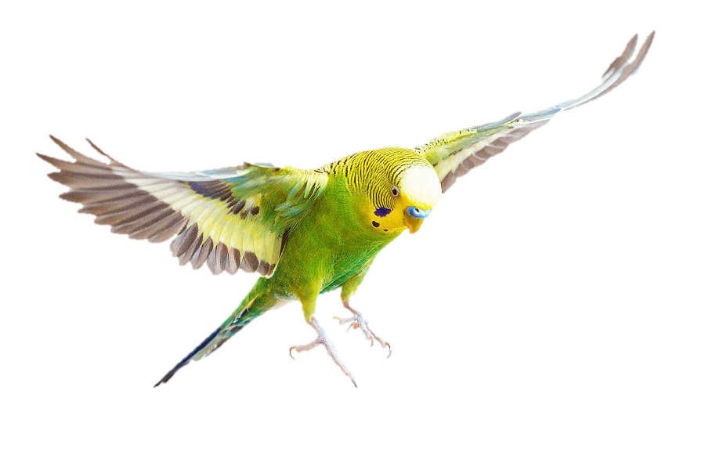

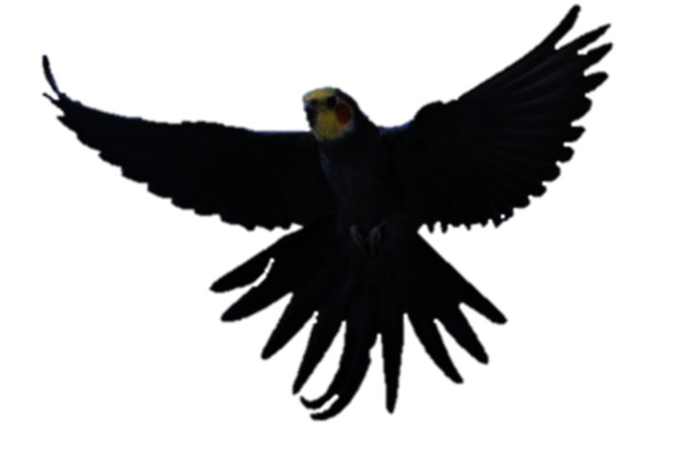
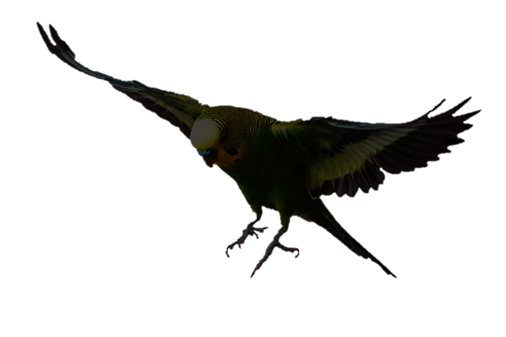
INTRODUCTION
So you’ve considered owning a pet bird. A good start to bird ownership would be to consider a smaller bird that is easier to take care of. Big birds are more than a handful, since they are smarter, stronger, and can live on to around the expectancy of an average human being. Most likely, they will outlive you and will go through many owners.
For starters, a parakeet is recommended. They are one of the easiest birds to take care of, and they can be tamed and taught tricks just like any other bird. Cockatiels are also good for beginners if you want to focus more on bonding with your bird, but are more of a handful. before considering either of these choices, or getting a pet bird in general, there are things that you must know before you buy.

Slide 3

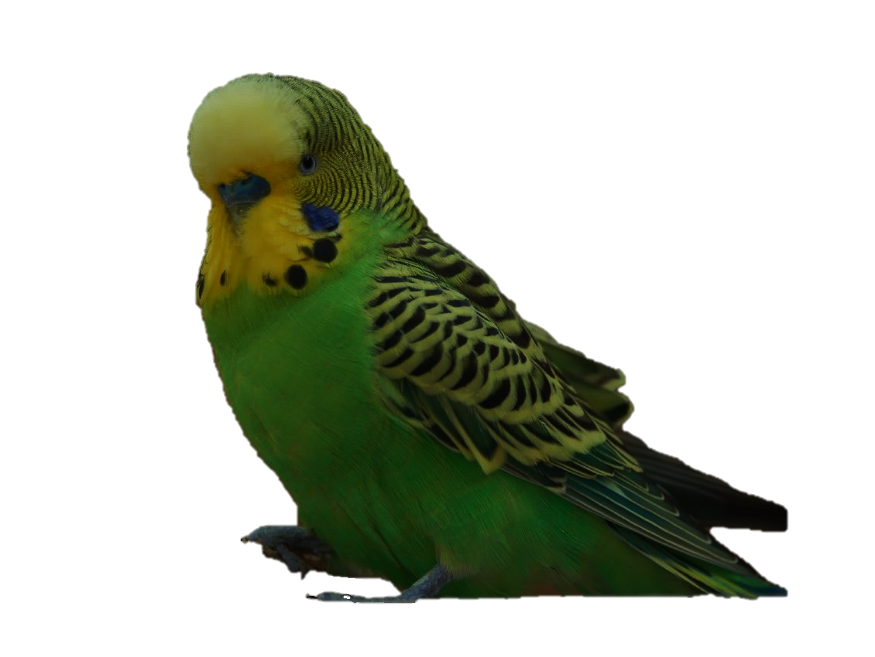
SEGMENT I
PARAKEET/budgie

Slide 4
About
The Budgerigar (Melopsittacus undulatus) or the budgie for short, is a small bird that is native in the Australian savanna. They are considered parrots, and the word “parakeet” IS ACTUALLY a group of birds (including the budgie) that have long tails and shorter sizes than average parrots.
Budgies are about 10 inches (25.4 cm), have a ring around their beaks with a color code relating to gender, and are commonly blue/white or green/yellow colored.
There are also English budgies which are bigger and more poofy than the standard budgerigar. Hybrids are also possible between regular and English budgies.

Slide 5
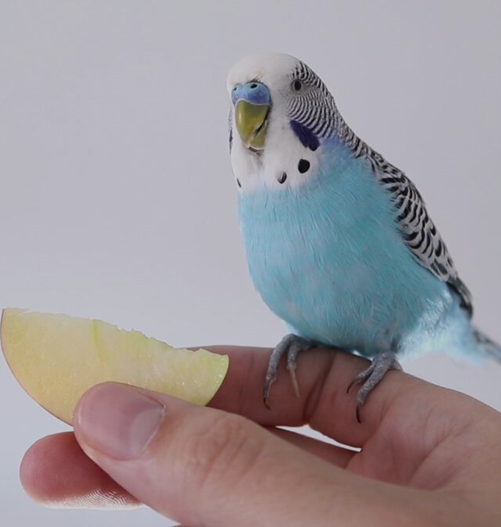
Loyalty
Parakeets are not dumb birds. they are capable of learning many things. Parakeets can learn how to talk just like any other bird, and can be tamed to the point of landing on you, or even flying to you. Keep hand feeding them millet, and they will eventually be your best friend.
If you want a budgie to talk, your best bet is to get a male and to not give him another bird, But make sure you have time for all of your bird’s affection by that time! Female budgies can be tamed, but they are more challenging to tame and are more aggressive, while also quiet and can’t talk. Make sure you try getting a male, unless you don’t care about bonding with your bird. But why would you get a pet if you don’t want to bond with it?

Slide 6
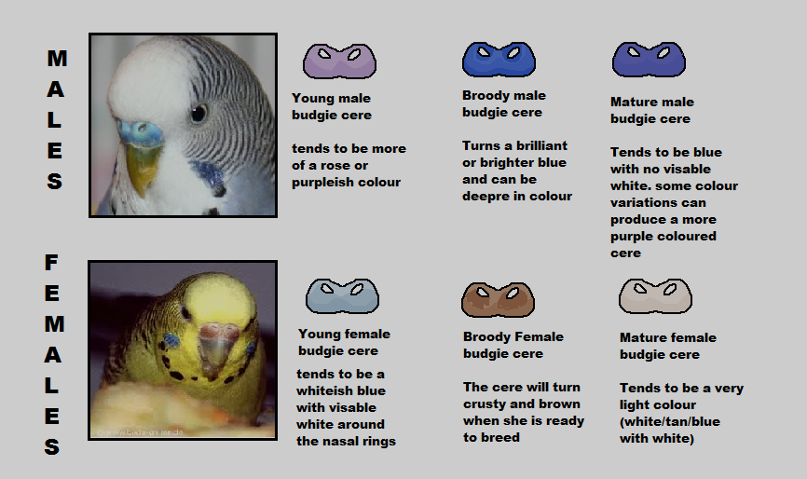

Gender & sex
To tell the gender of a budgie, look no further than the nose ring around its beak. The budgie on this presentation is a male due to its blue color. It is harder to tell the gender when they are in their young years, but it’s not impossible.
To the right is a chart that shows the difference between males and females, young and old.
Female budgies; like all birds, can lay infertile eggs and can be aggressive due to their nature of protecting their young. Males usually never seem to do any sexual behaviors unless in presence of another bird, most likely a female.
I am a male!

Slide 7
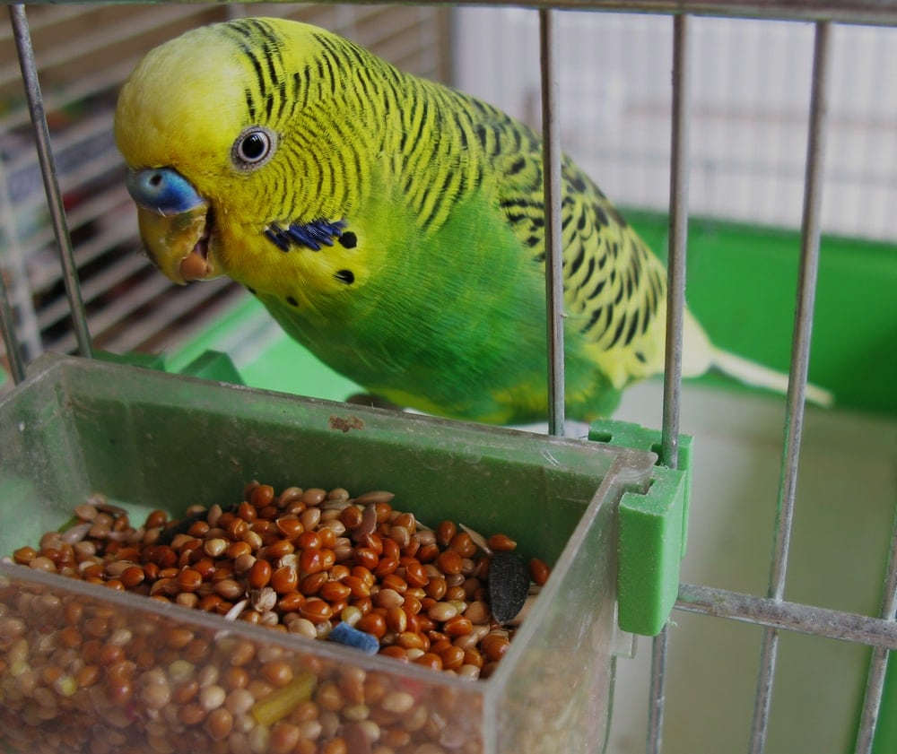
Care
Parakeets are the easier ones to take care of, but they can still be a handful. Although the poops are small, they can still do it anywhere. You still have to clean up after it a decent amount.
The budgie needs about 10-12 hours of sleep, less than that of a cockatiel. Make sure your budgie has enough time out of the cage, and if you want to prevent nesting in females, give it some cage time as well, although this may be hard because the budgie is skittish. Also make sure nothing scares your budgie, especially things that scare it away from you.

Slide 8
Tips
Parakeets are skittish birds, due to their nature. It may make it a bit more challenging to take a budgie than a bigger bird, but it’s not that hard.
To prevent egg laying, close dark corners and places your bird can hide in.
To prevent landing on certain furniture, use tin foil.
Although it is possible to get your budgie a harness for trips outside the house, it is a very challenging process to get them used to one.
When taming, hand-fed millet is your best bet. It will be a long while until your budgie eats seeds from the palm of your hand.

Slide 9
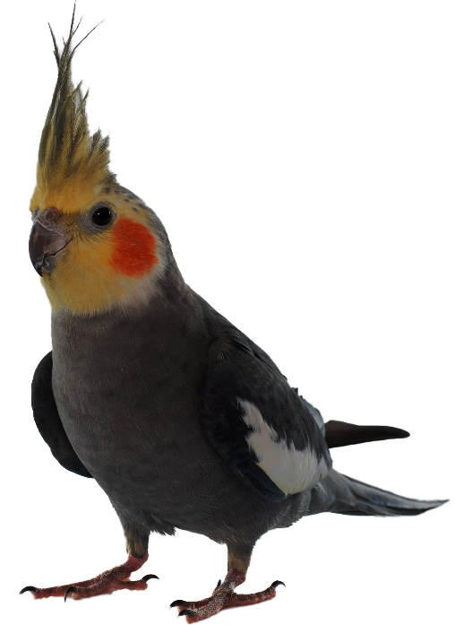
SEGMENT II
COCKATIEL

Slide 10
About
The cockatiel (Nymphicus hollandicus) is neither a parrot, nor a cockatoo. They share similar traits from the two, but are different enough to be considered their own. These birds are native to the Australian savanna, along with the beforementioned Budgerigar Parakeets.
Cockatiels are about the size of 1 foot (30 cm), express emotion through their crest, and can have cheeks where their ears are.

Slide 11
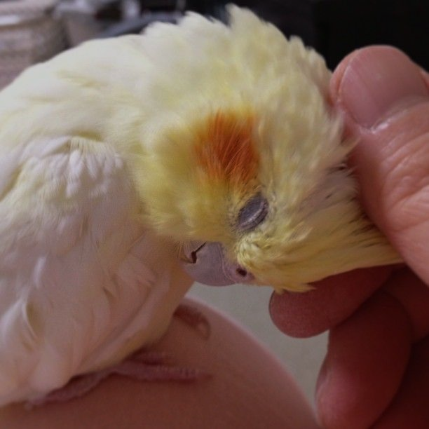
Loyalty
Just like most other birds, cockatiels can be tamed and taught how to talk. These birds also are known for their ability to whistle.
Same thing as a budgie, your best bet in a talking or whistling cockatiel is to get a male, and to not give him another bird. Even more so than a budgie, cockatiels need even more of your affection! Female cockatiels can be tamed, but they can still have a hard time learning tricks, and are extremely aggressive. And of course, they are still quiet and can’t talk. Female cockatiels in general aren’t really too much of a good choice, which is a story for another slide.
One other thing is that it is easier to pet your cockatiel once it is used to you, regardless of what gender. They love their heads scratched, unless you don’t do it right…

Slide 12
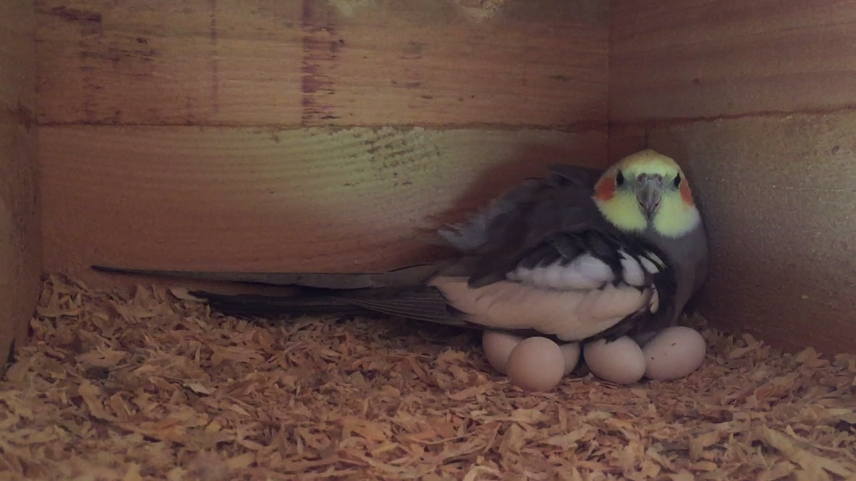
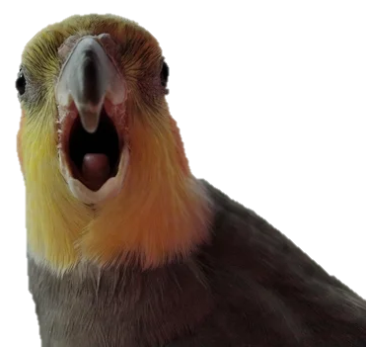
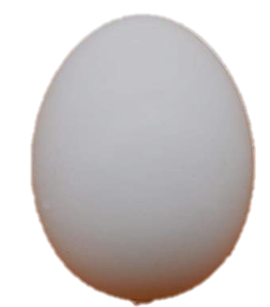
Gender & sex
Some cockatiel breeds can allow gender proof through the way their feathers are designed, but that method isn’t that reliable. Male cockatiels can whistle, talk, are louder, and are less aggressive than females, who are quiet, and more aggressive. Nesting behaviors also point towards a female. By observing your cockatiel’s personality, it can give you a good idea on its gender, but the most surefire ways of finding out are through DNA tests (which can be traumatizing for your bird) and if you see your bird laying an egg.
Females are infamously known for constant, non-stop egg laying (Fertile or not). Female cockatiels will try to attack anyone who approaches their chosen nest with eggs inside. Cockatiels can draw blood, unlike the budgie.
This is why a male is more recommended, unless breeding two birds together.
I am a female!

Slide 13
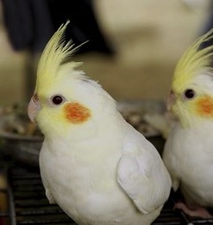
Care
Taking care of your cockatiel may seem easy at first, but they are harder to clean up after than a parakeet because they can cause more damage, chew wires, make bigger poops, and cause bigger messes. Sometimes, your cockatiel will take one giant poop in the morning, so you better hope that poop is in its cage.
Make sure your cockatiel gets 12-14 hours of sleep, and get a good amount of cage time. Letting it run around the house for long enough will increase the likelihood of nesting (in females) and bad behavior. Make sure your cockatiel is getting time outside the cage, too. And of course, make sure they are busy. Give them foraging trays, and other stuff to do.
Cockatiels also have high dander emission rates, so give your cockatiel a bath twice or three times a week, but keep it warm, and make sure they are ready for it.

Slide 14
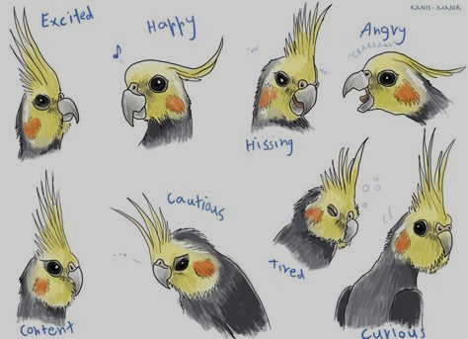
Language
Cockatiels can show their emotions through their crest, much like we do through our faces. This makes it easy to tell how your cockatiel feels. The image on the right shows some of the emotions a cockatiel can express through their crest.
Now let’s talk about sounds your cockatiel will make. One of the “emotions” on here is “hissing”, which shows how a cockatiel may look when it is hissing. Cockatiels hiss when they are mad or defensive, much like geese and cats. Most people don’t know a cockatiel can hiss until they see it for themselves. When a cockatiel is happy, it will grind its beak.

Slide 15
Tips
Cockatiels can nip at you for a lot of reasons, and can be annoying. They don’t hurt usually.
To prevent egg laying, close dark corners and places your bird can hide in.
To prevent landing on certain furniture, use tin foil.
If you want to take your cockatiel out without clipping its wings, get it used to a flight suit, which is like a harness. Some even have diapers.
Cockatiels will learn whistling a little better if you can pause between each whistle for a few seconds, while repeating. This lets your bird process the tune into its mind.

Slide 16
SEGMENT III
Last Tidbits

Slide 17
Both?
Want both? Think you can handle it? If you want both, make sure you get them two separate cages, as it’s more challenging to keep two birds of different species in the same cage. Most likely, these birds will get along, but keep an eye on their personalities. Male budgies are usually more laid back and friendly, and cockatiels in general can be more moody. It’s possible for a male and female to get along, and they shouldn’t mate. Females and females can get along, too, it’s just male and male is easiest.
Both birds may eat each others’ food, so make sure you get the right food for both of them, but if you get good enough food, it shouldn’t harm one species to eat the food meant for the other one.
And yes, either one will stop talking with the other as a buddy. One interesting thing is that
Males will mimic the sounds of the other bird
They spend time with.

Slide 18
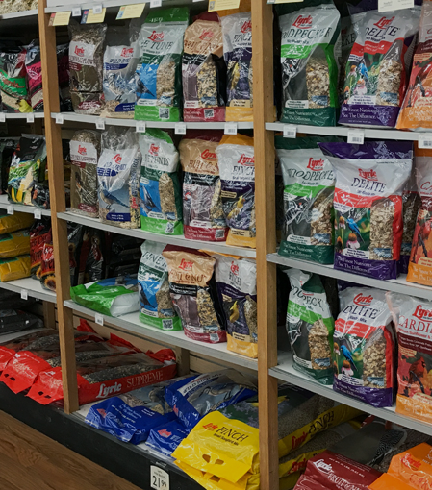
Food
Bird food is a very important thing to keep eyes on, because there is a lot of bird food out there that can cut the lives of birds short. Avocado, apple seeds, caffeine, chocolate, fats, salt, garlic, onions, and xylitol are all foods that can kill your bird. Avoid seed with fillers, as your bird will only throw it and make a mess.
Your bird will need a diet based on 25% seeds and 75% pellets. Most fruits and vegetables are a good thing once in a while.
Millet is a good way to train your bird or bond with your bird, since it is easy to feed and birds love it.
Finally, you are going to need to buy high quality, high price bird food and produce to ensure your bird is in good health. Can’t afford it? Maybe birds aren’t the answer for you.

Slide 19
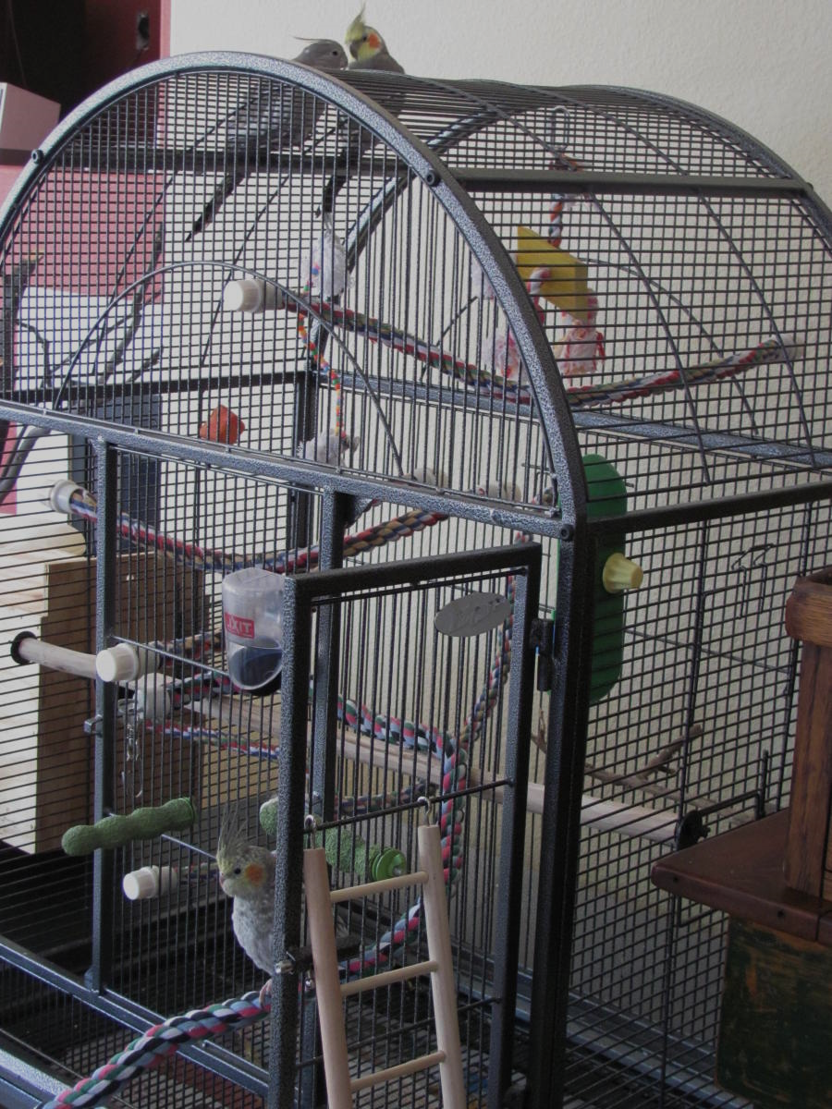
Shelter
Your bird’s cage needs to be nice and roomy, much bigger than their actual size. Make sure to get a rectangular cage with horizontal bars that aren’t too far away from each other. Make sure the cage has no sharp ends or easy ways for your bird to escape. Place the cage by an area with sunlight in an area where there is the most activity. Usually people put their bird’s cage in the living room.
Inside the cage, place food and water dishes in easily accessible places in which you can reach. Put perches and toys that aren’t soft (soft toys encourage mating behavior), so the cage is an exciting and safe place to be.
When putting your bird back in your cage, you may have to do it by force. Lure it with food if you have to. If you don’t want your bird to get scared of your hand, use a glove or small cloth. Do not cover your bird, and Make sure you grab the bird gently.

Slide 20
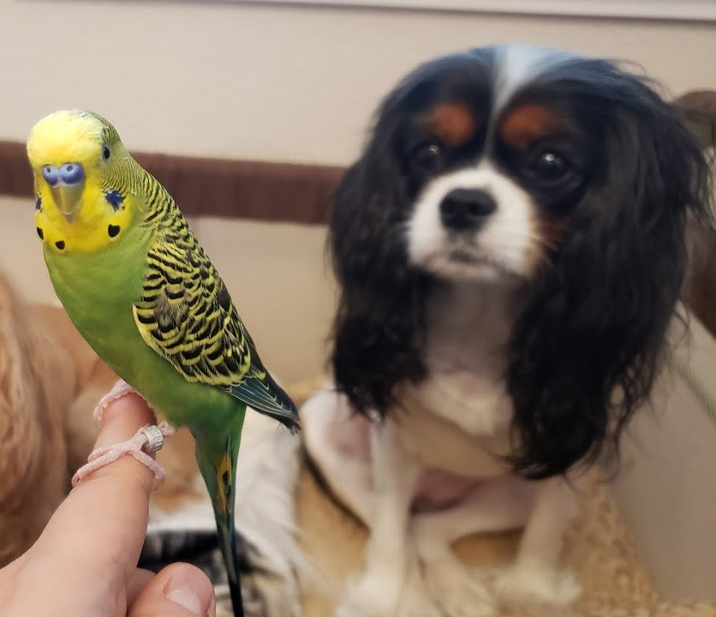
Other Animals
Even birds as small as parakeets may be able to get along with other pets in the home. For dogs, small dogs are the best bet, as big dogs have a higher risk of killing your bird. However, big dogs and birds getting along are possible.
Teaching your dog how to get along with your bird is to discourage killing of the bird. You may need to hold your dog from the bird for a while, but try to tell your dog to stop with a stern “no”, as it will start to work eventually. Do not let your bird on the floor until the dog is trained.
Although cats are possible, they have more natural instincts toward bird hunting, and claws that can kill your bird faster. The “no” strategy from before may work, but you may have luck with a certain personality of cat.

Slide 21
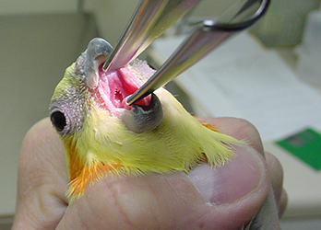
Vets
Avian vets are incredibly rare to find, and when you do find them, they’re usually busy. This is why you should learn how to properly care for a sick bird, as birds as small as budgies and cockatiels can die from small infections.
When your bird is sick, it may act unnormal, have a different appearance, stop moving around that much, even vomit, or go to the bottom of the cage. Immediately put your bird in a warm, isolated environment, and give it the nutrients it needs to fight off the disease. Perch warmers and heaters can help.
But even then, you shouldn’t hold off a visit to the vet. You should get your bird a designated vet as well.

Slide 22
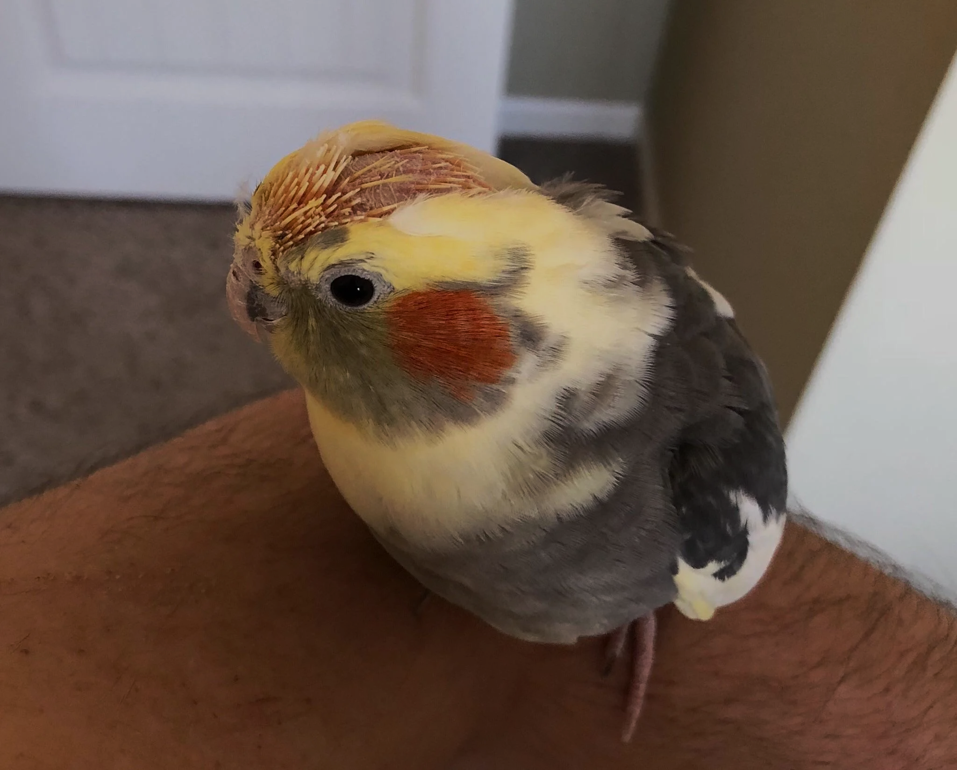
Don’t Dos
You must never do any of the following:
Buy a bird for the sole purpose of making your house look pretty or to hear it sing.
Harm your bird in any way, no matter what.
Arouse your bird
Underestimate your budget and your ability to take care of a bird
Not pay attention to your bird
Breed two birds together without knowing the professional way of doing so, or force two birds to mate whatsoever.
Yell at your bird
Leave your bird in filth

Slide 23
Conclusion
Now that we’ve gone over these very important things you need to know about bird ownership, I hope you have made your final decision.
Birds can be a handful sometimes, but that doesn’t stop a lot of people from taking care of them. They can be loyal and sweet, even though some can be more aggressive than others.
I also hope you all learned some new things from this presentation, and most importantly, hope you enjoyed it.

